Slide 1


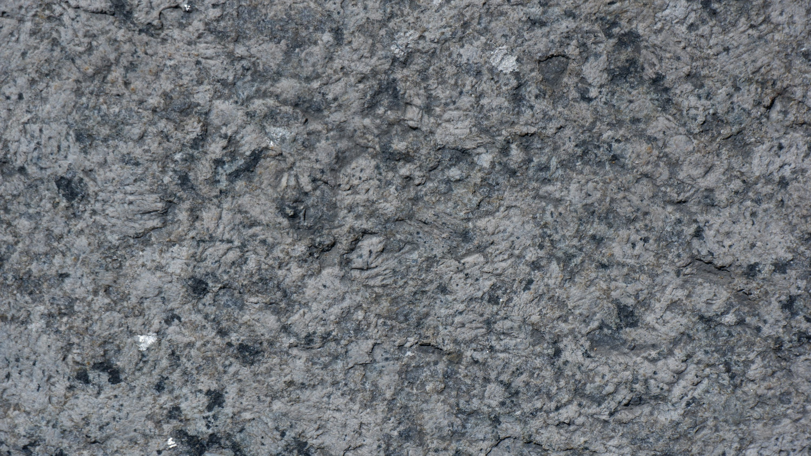
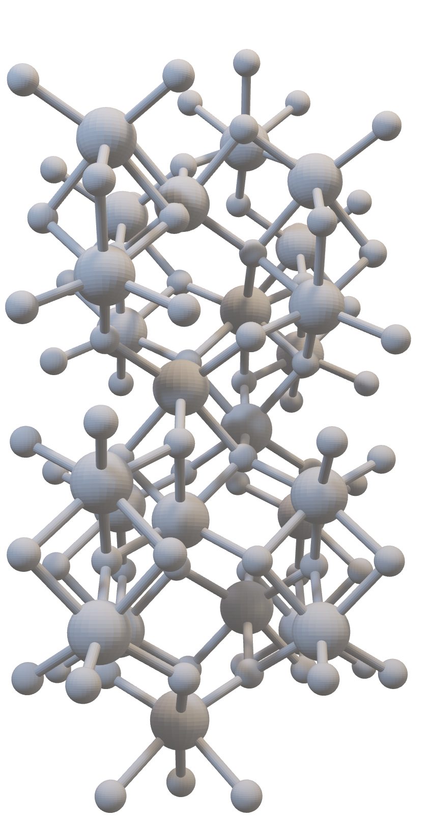
Crystal
Classification
CSCI2291 SPRING 2025 FINAL PROJECT
Myles Grant Jaden Park
2
Methodology
Materials Project
Features
Preprocessing
Models
1
Motive/Goal
Materials Prediction
Crystal Lattice
Properties
3
Results
Linear with ENR
Polynomial with ENR
XGBRegressor/Classifier

Slide 2
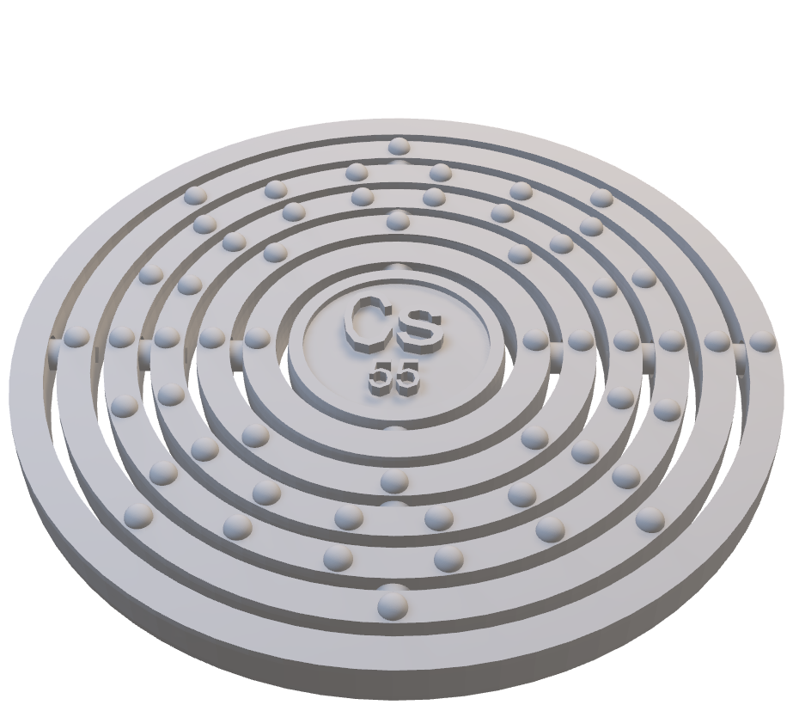

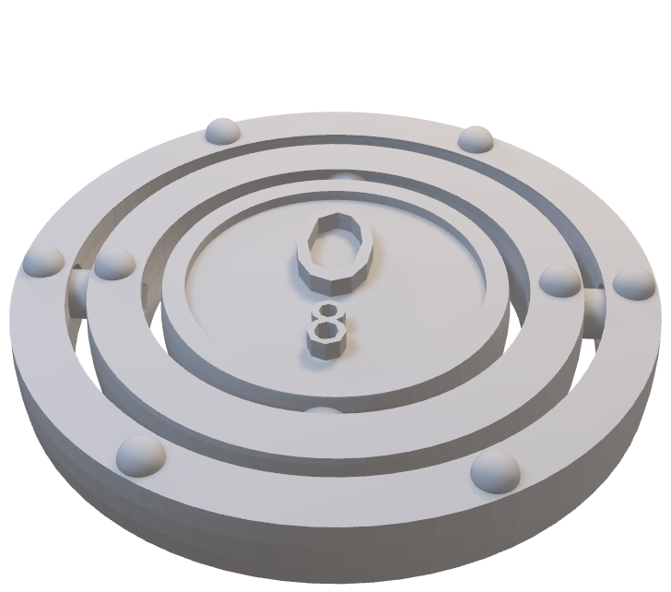
Crystal
Classification
CSCI2291 SPRING 2025 FINAL PROJECT
Myles Grant Jaden Park
1
2
3
Motive/Goal
Materials Prediction
Crystal Lattice
Properties
Methodology
Materials Project
Features
Preprocessing
Models
Results
Linear with ENR
Polynomial with ENR
XGBRegressor/Classifier
Motive
Approx. 300,000 materials currently known
Potentially millions more possible materials
Fundamental for infrastructure, energy, computation, medicine, research, quality of life
Finding best materials for specific solutions has strong and immediate benefits.

Slide 3
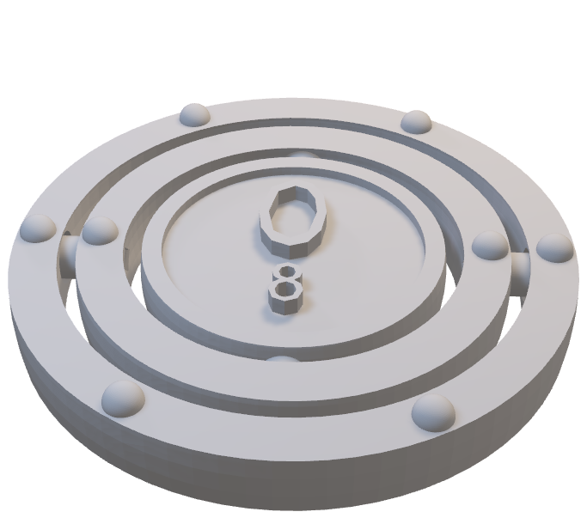

3
Results
Linear with ENR
Polynomial with ENR
XGBRegressor/Classifier
1
Motive/Goal
Materials Prediction
Crystal Lattice
Properties
2
Methodology
Materials Project
Features
Preprocessing
Models
Motive
Approx. 300,000 materials currently known
Potentially millions more possible materials
Fundamental for infrastructure, energy, computation, medicine, research, quality of life
Finding best materials for specific solutions has strong and immediate benefits.

Slide 4
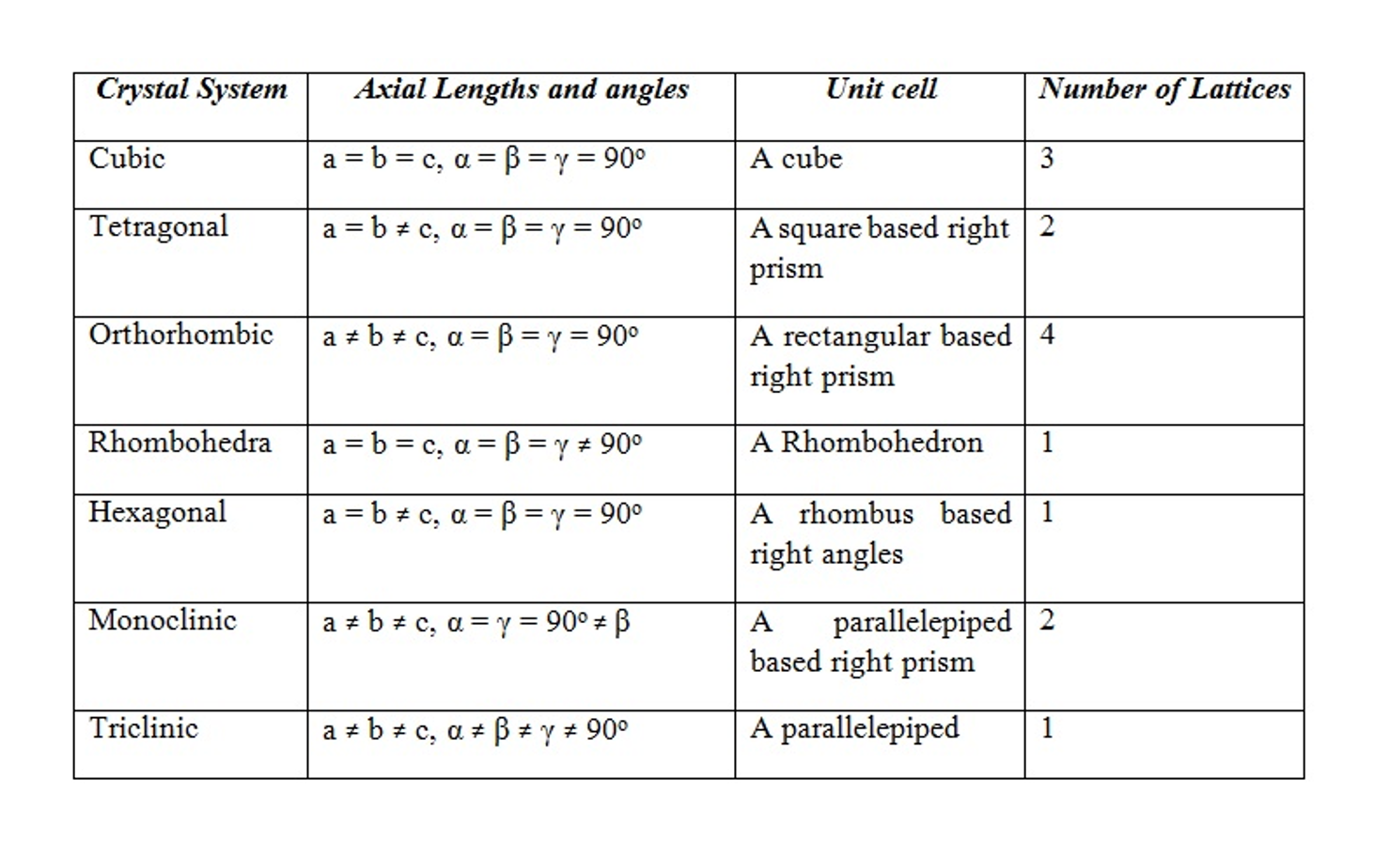
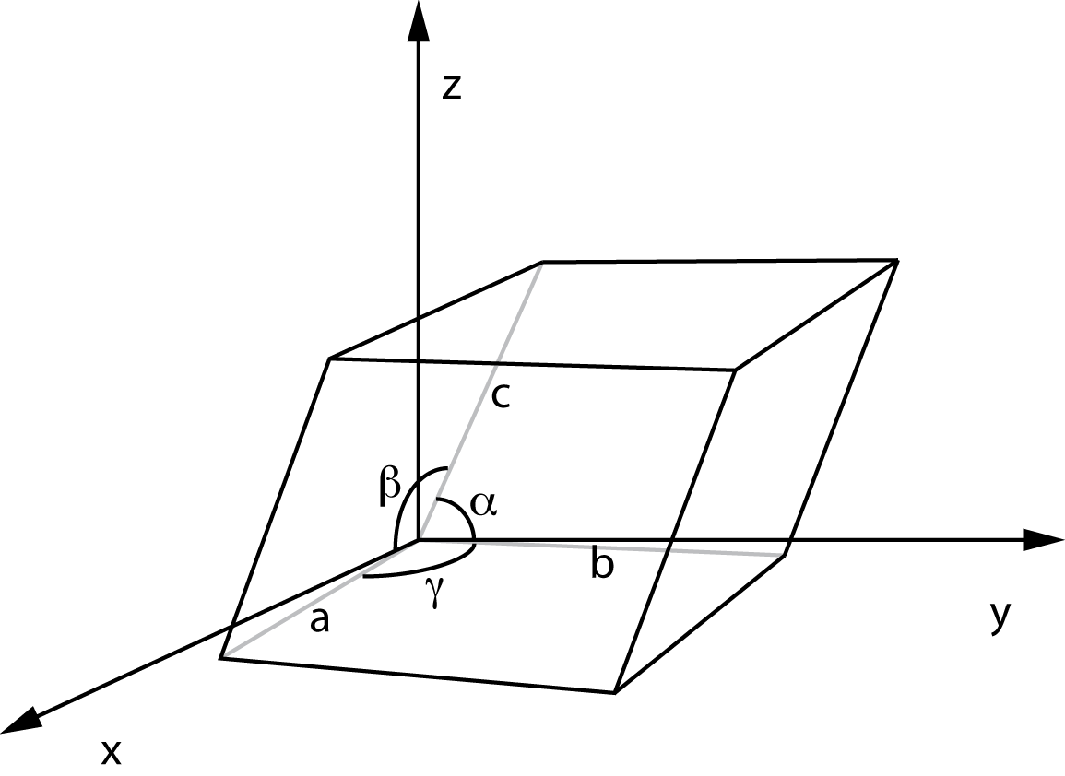
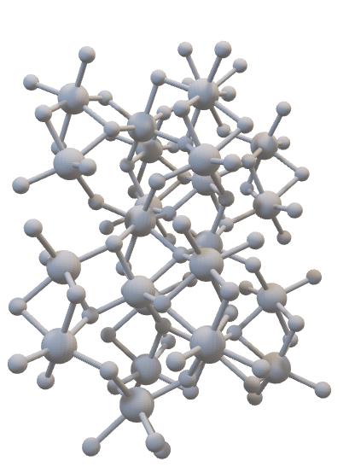
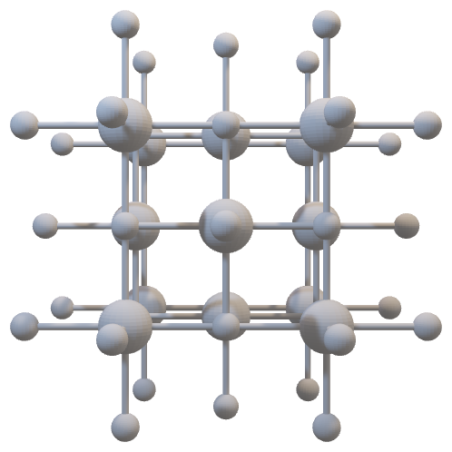
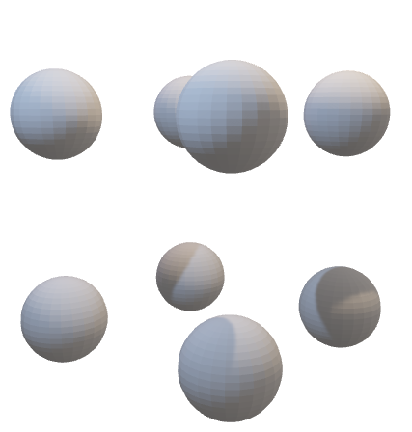
CRYSTALS
NaCl
Al₂O₃
Po
Solids
Amorphous vs Crystals
Unit Cells (Lattice Constants)
Fundamental to properties of materials
Notes:
The solid state of materials is one we interact the most with, and can be split into two categories: amorphous and crystalline
crystals are defined as a solid material with a repeating structure.
This means that we can define a unit cell (like a lego block) with side length and angles that remain constant and can describe the whole structure with only the translation operation

Slide 5
Properties
Mechanical (stiffness, elasticity, hardness)
Thermal (heat capacity, thermal conductivity)
Electric (dialectric constants, band gap)
Optical (refraction, absorption, optical band gap)
Magnetic (permeability, coecivity, hysteresis
Chemical (corrosion, oxidation, reactivity, solubility)
Topological (edge/surface states, transport, spin-momentum)
Functional (healing, piezoelectricity, memory)

Slide 6

Database
Materials Project Database
material_id
formula_pretty
elements
nelements
band_gap
density
formation_energy_per_atom
energy_above_hull
bulk_modulus
shear_modulus
volume
nsites
total_magnetization
structure
unique id of the material
chemical formula
elements in the crystal
number of elements
conductivity of material
mass density
energy released/absorbed during formation
lowest energy above convex hull (stability of material)
resistivity to stress
resistivity to shear
volume
# of atomic sites
total magnetization
lattice constants

Slide 7
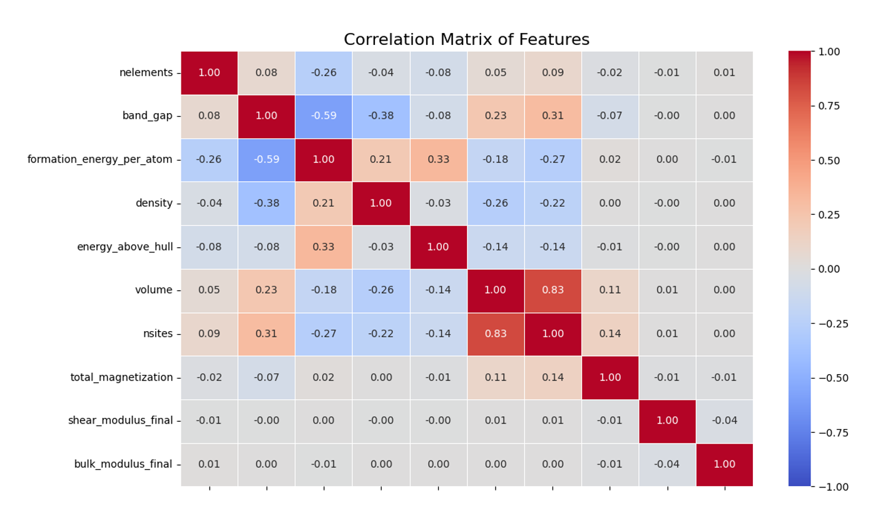
PREPROCESSING
Data cleaning
Train/Test Split
Removed outliers
Scaled and Standardized
Principal Component Analysis
Notes:
Data cleaning (missing/incomplete data)
Train/Test Split
Removed outliers
Scaled and standardized
- Log scale on shear and bulk modulus
Perform Principal Component Analysis (not needed because features not highly correlated)

Slide 8
Linear (Elastic Net Regression)
Polynomial (Elastic Net Regression)
XGBRegressor/XGBClassifier
M
O
D
E
L

Slide 9
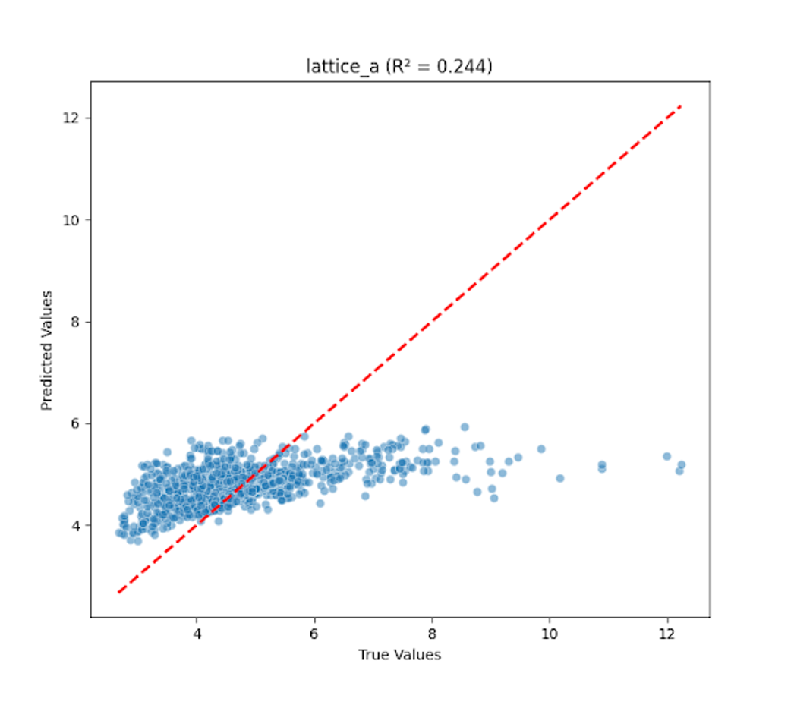
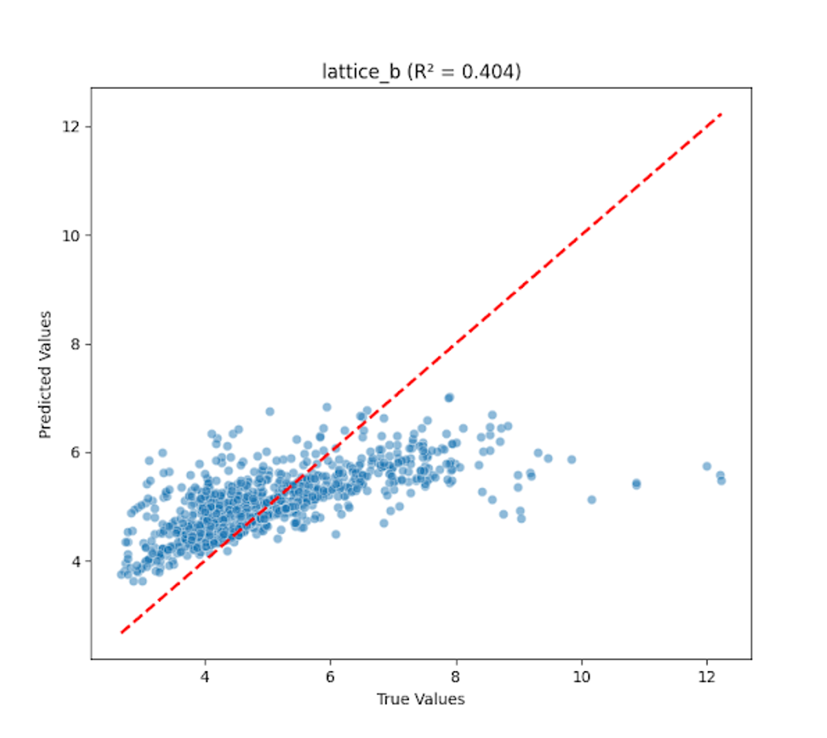
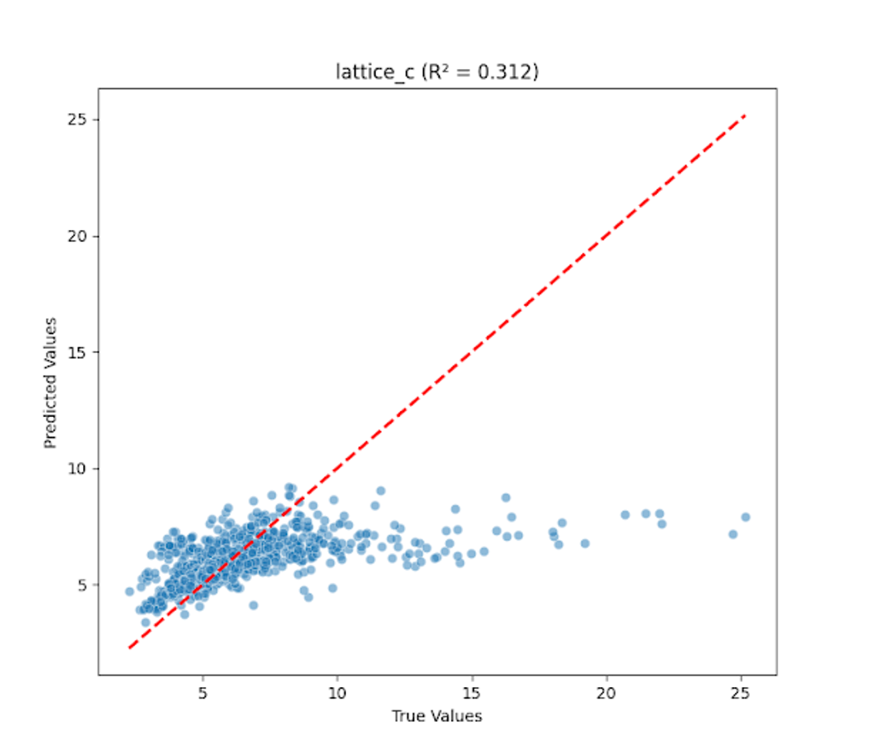
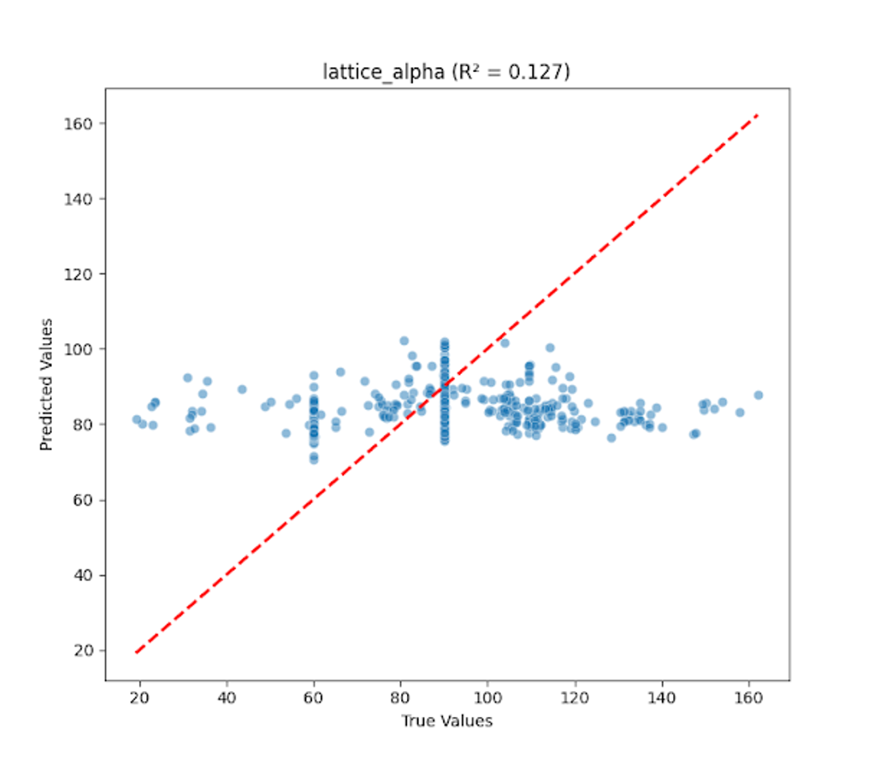
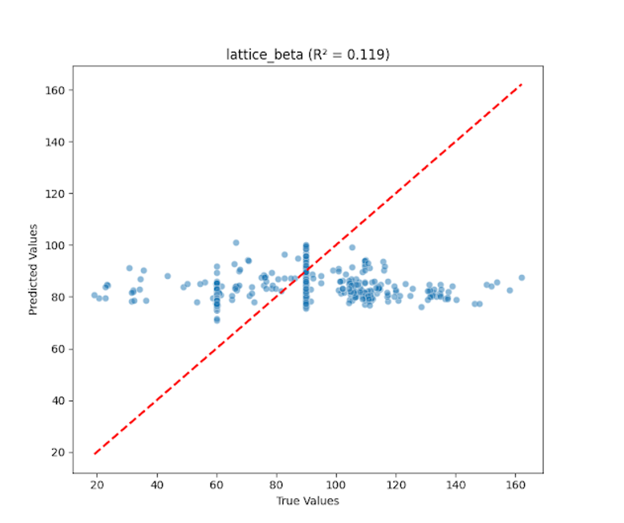
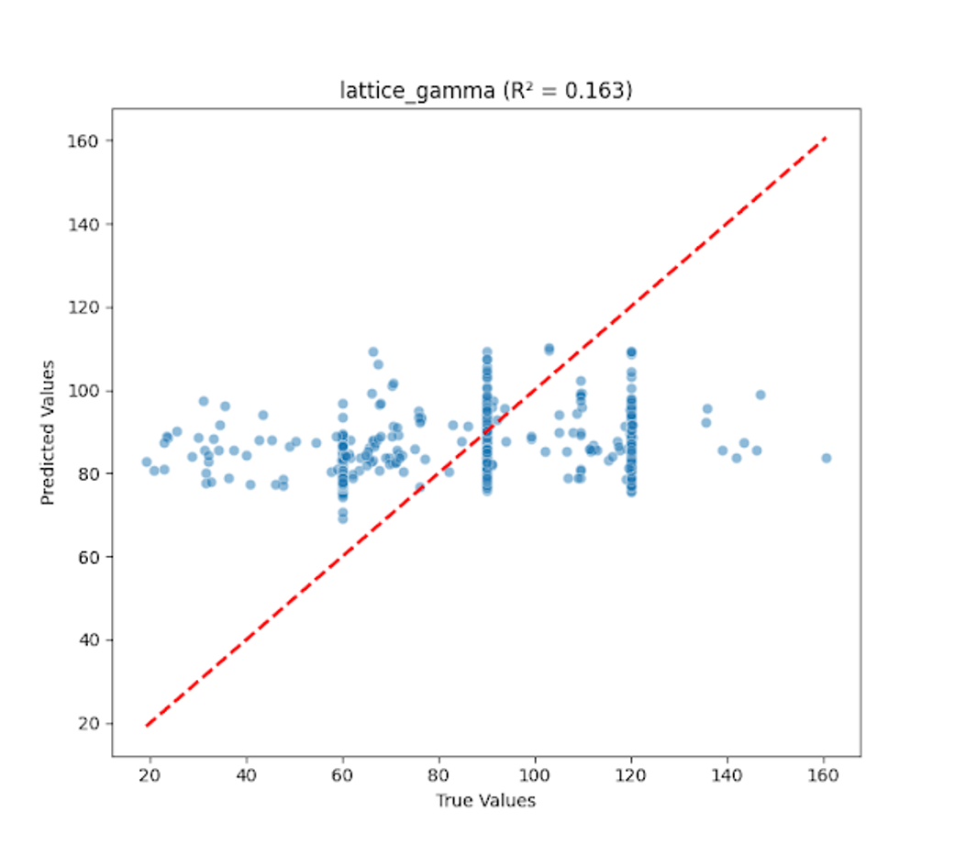
Linear Model
(Elastic Net Regularization)
Optimized ElasticNet Model Performance:
R² = 0.228
MSE = 209.458
lattice_a:
R² = 0.244
MSE = 1.096
lattice_b:
R² = 0.404
MSE = 0.981
lattice_c:
R² = 0.312
MSE = 4.442
lattice_beta:
R² = 0.119
MSE = 372.869
lattice_alpha:
R² = 0.127
MSE = 379.299
lattice_gamma:
R² = 0.163
MSE = 498.064

Slide 10
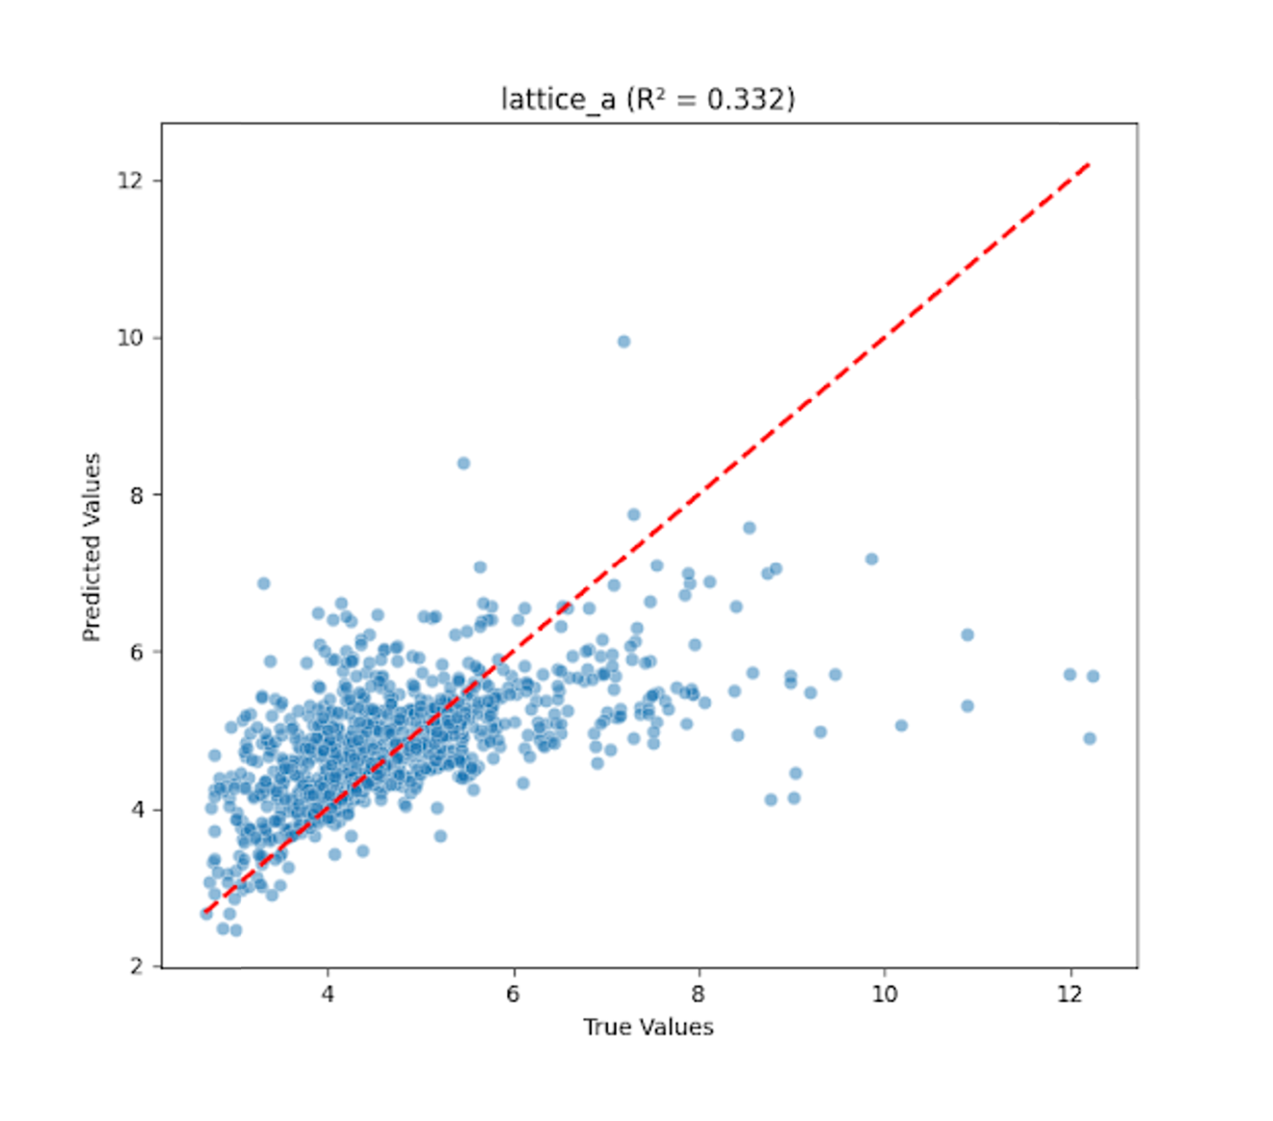
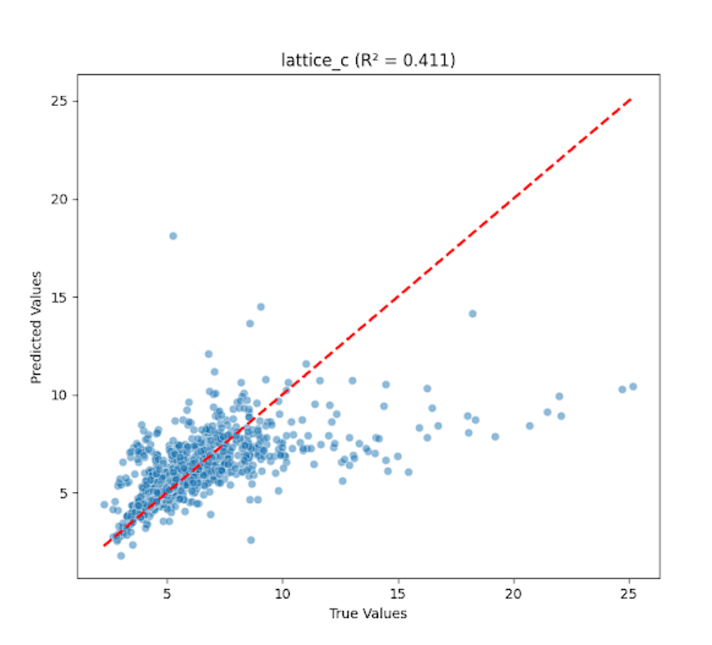
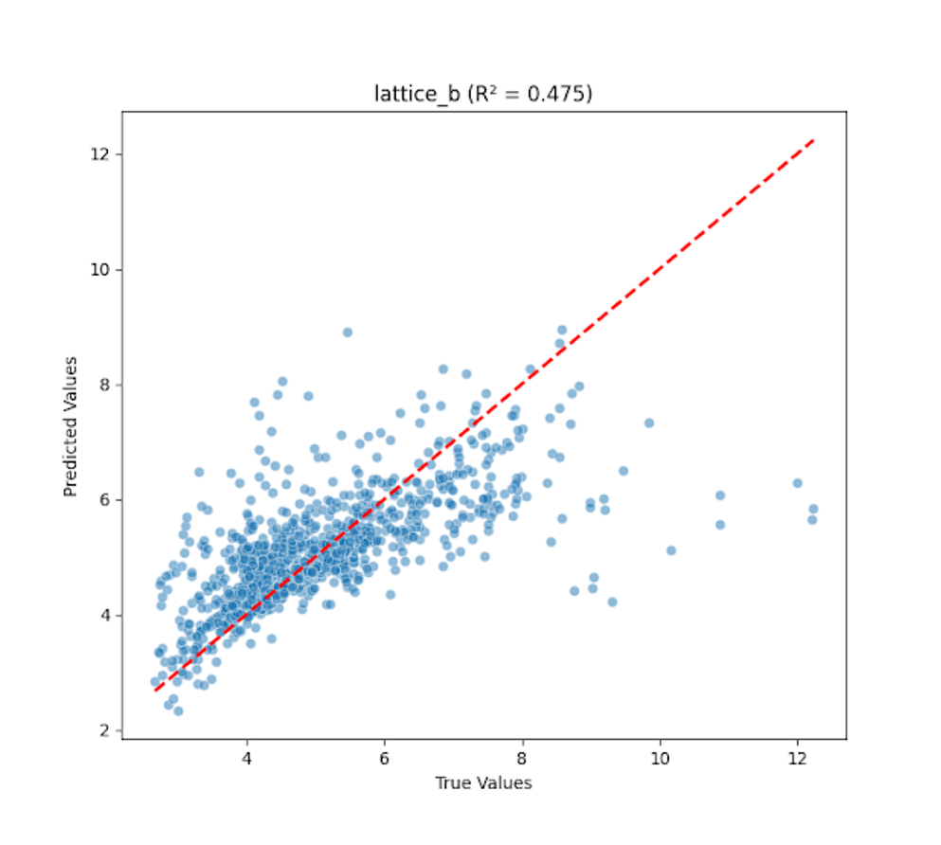
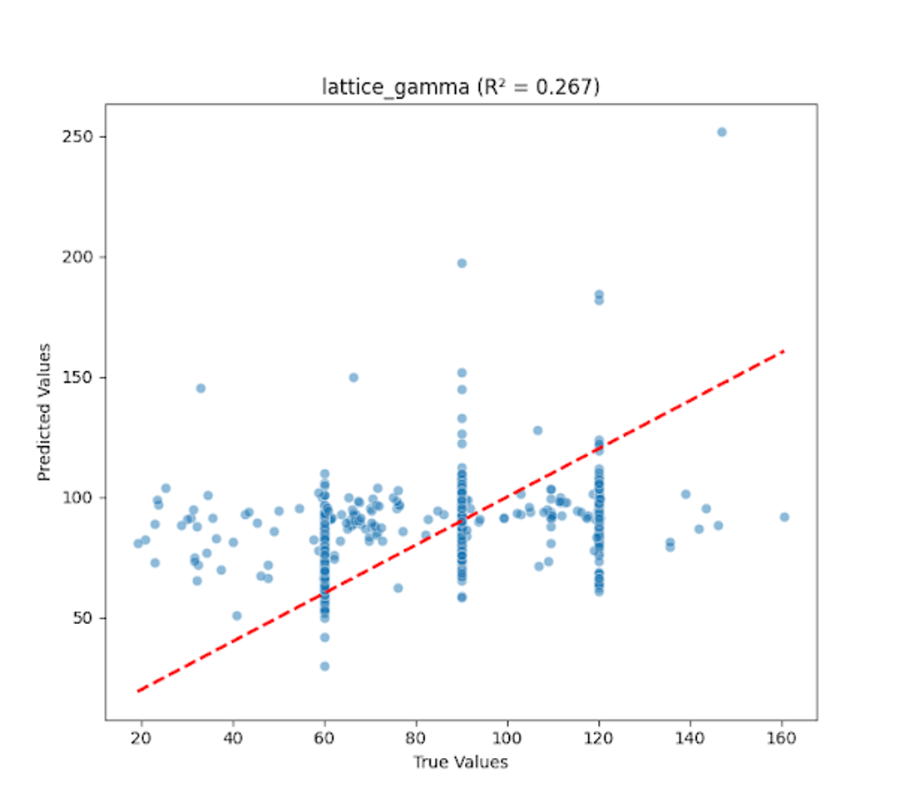
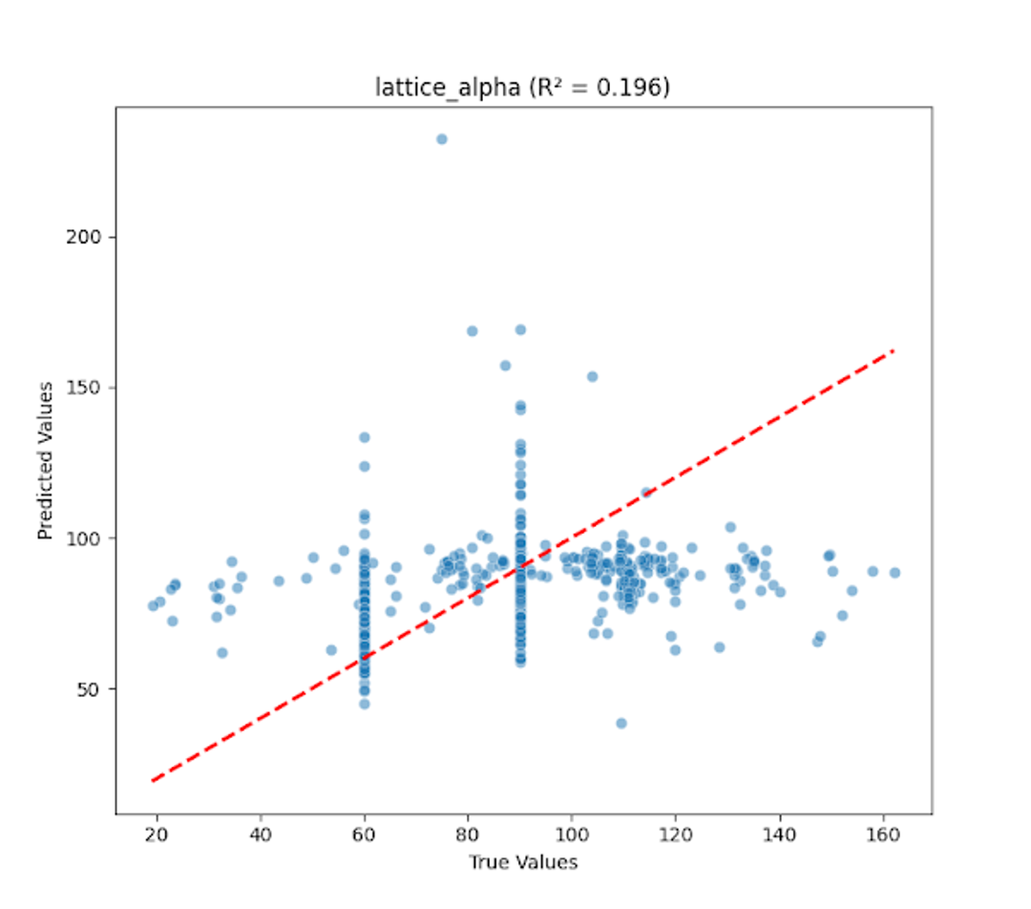
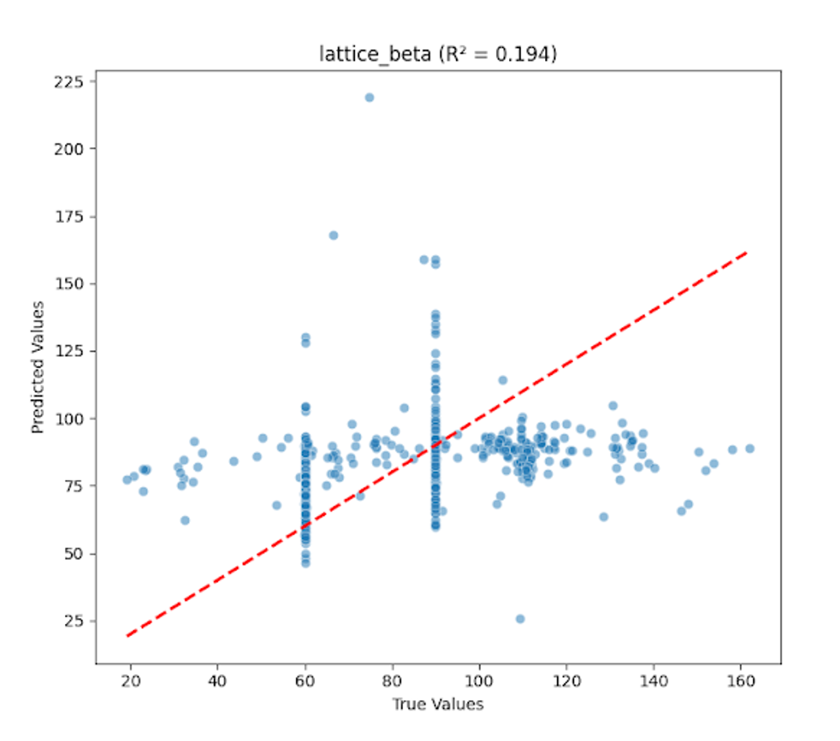
Polynomial Model (Elastic Net Regularization)
Metrics
Optimized Polynomial Regression Model Performance:
R² = 0.312
MSE = 188.704
Performance Metrics per Output:
lattice_a:
R² = 0.332
MSE = 0.968
lattice_b:
R² = 0.475
MSE = 0.865
lattice_c:
R² = 0.411
MSE = 3.802
lattice_alpha:
R² = 0.196
MSE = 349.356
lattice_beta:
R² = 0.194
MSE = 340.983
lattice_gamma:
R² = 0.267
MSE = 436.249

Slide 11
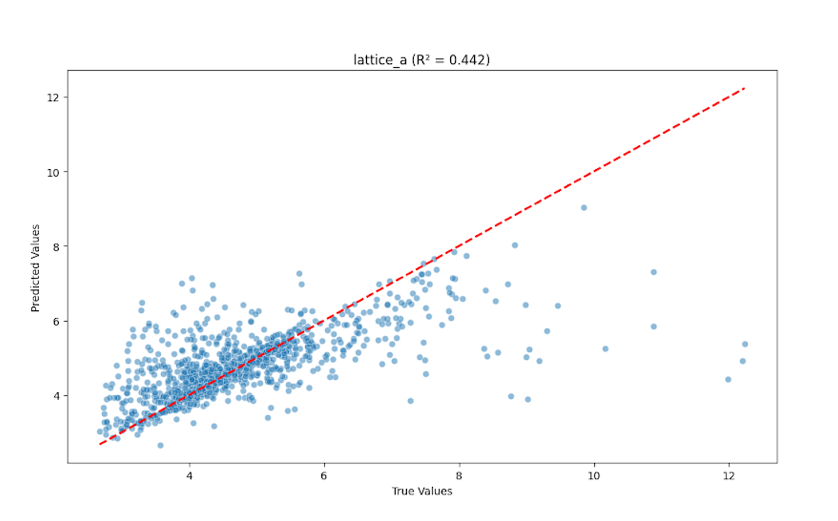
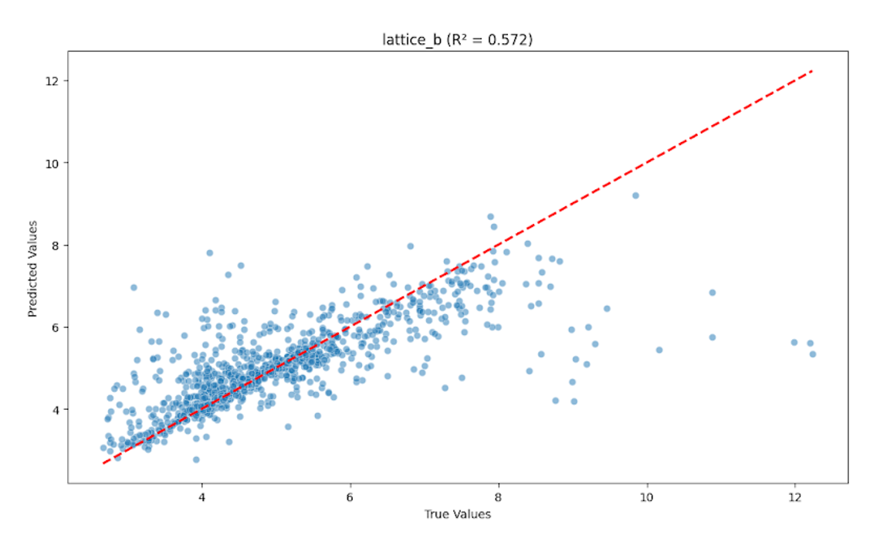
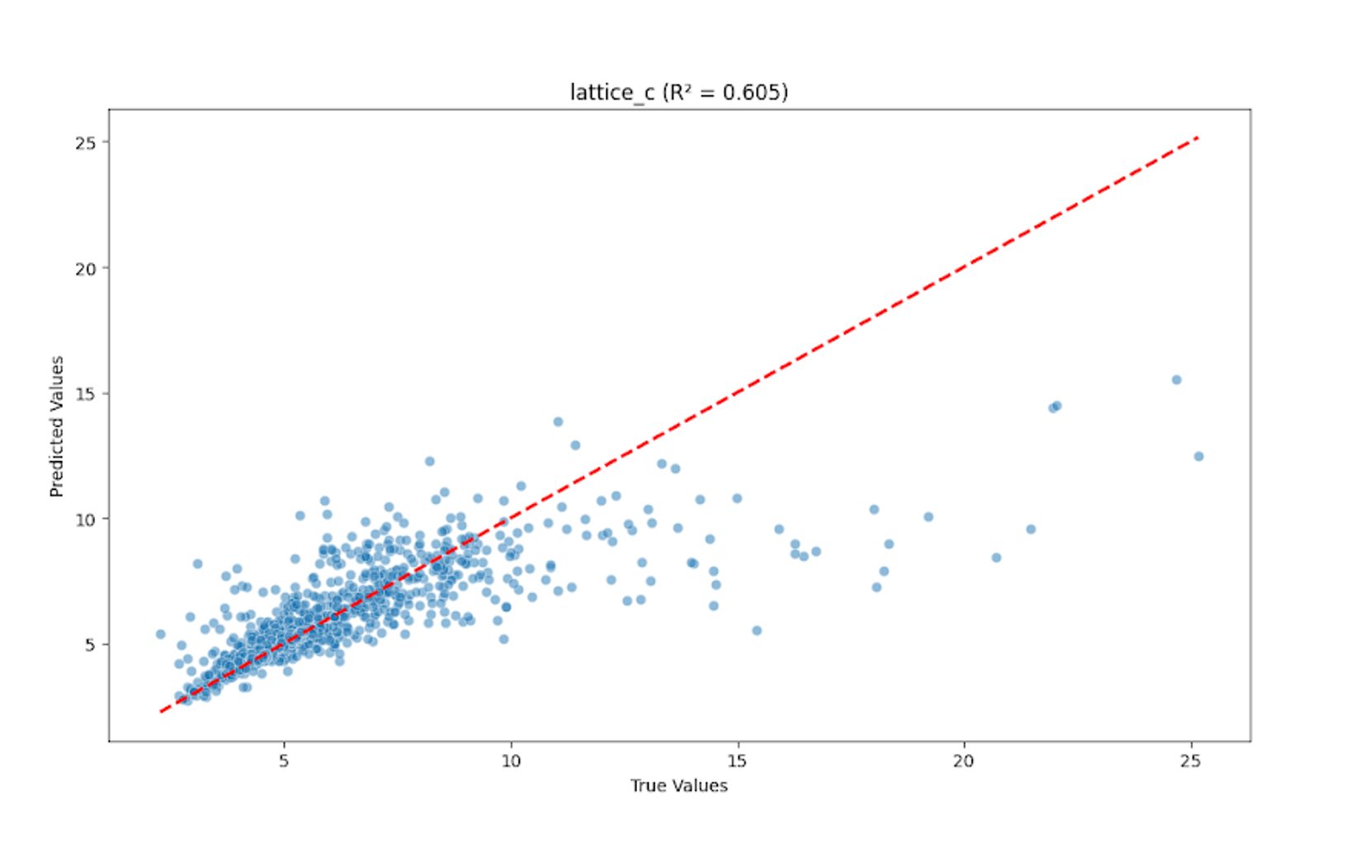
XGBRegressor / xgbClassifier Model
Training model for: lattice_c
Mean R² = 0.555
Training model for: lattice_a
Mean R² = 0.461
Training model for: lattice_b
Mean R² = 0.590

Slide 12
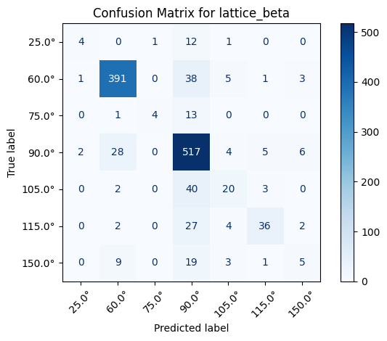

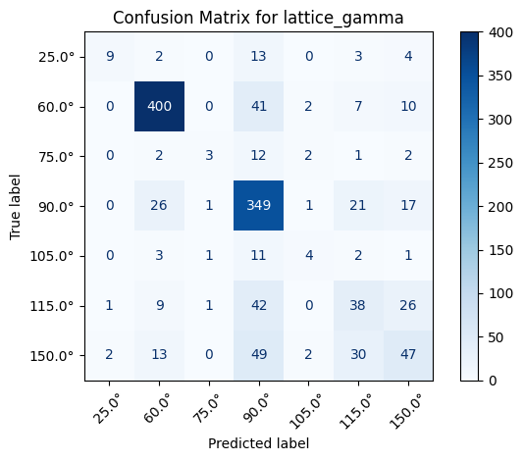
The XGBoost model developed for predicting lattice parameters and angles demonstrated solid overall performance, particularly in the classification tasks. For the regression targets—lattice_a, lattice_b, and lattice_c—the model achieved mean R² scores of 0.461, 0.590, and 0.555, respectively. These scores indicate that the model can explain approximately 46% to 59% of the variance in the respective target variables, reflecting a moderate level of predictive accuracy. In contrast, the classification tasks for lattice_alpha, lattice_beta, and lattice_gamma yielded stronger performance, with macro-averaged F1 scores of 0.800, 0.807, and 0.702, respectively, demonstrating effective generalization and balanced precision-recall tradeoffs across the angle bins.
The modeling approach employed several advanced techniques to optimize performance. XGBoost was used as the core algorithm for both regression and classification tasks due to its efficiency and strong performance in handling structured data. Hyperparameter optimization was carried out using RandomizedSearchCV with 5-fold cross-validation, allowing the model to explore a broad hyperparameter space in an efficient manner. Key hyperparameters tuned included the number of estimators, learning rate, maximum tree depth, subsample ratios, and column sampling rates, in addition to two regularization parameters: reg_alpha for L1 regularization and reg_lambda for L2 regularization.
Training model for: lattice_alpha
Mean F1 = 0.802
Training model for: lattice_beta
Mean F1 = 0.810
Training model for: lattice_gamma
Mean F1 = 0.704

Slide 13
Possible explanations for results + future steps

Slide 14
References

